Slide 1

Development of machine learning models to process Electronic Health Records – Imputation Strategies
Week 17 Meeting, 13/2/2021

Slide 2
'Alanine aminotransferase', 'Albumin', 'Albumin ascites',
'Albumin pleural', 'Albumin urine', 'Alkaline phosphate',
'Anion gap', 'Asparate aminotransferase', 'Basophils',
'Bicarbonate', 'Bicarbonate urine', 'Bilirubin', 'Blood culture',
'Blood urea nitrogen', 'Calcium', 'Calcium ionized',
'Calcium Ionized', 'Calcium urine', 'Capillary refill rate',
'Chloride', 'Chloride urine', 'Cholesterol', 'Cholesterol HDL',
'Cholesterol LDL', 'Cholesterol Pleural',
'CO2 (ETCO2, PCO2, etc.)', 'CO2', 'Creatinine',
'Creatinine ascites', 'Creatinine body fluid',
'Creatinine pleural', 'Creatinine urine',
'Diastolic blood pressure', 'Eosinophils',
'Fraction inspired oxygen', 'Fraction inspired oxygen Set',
'Glascow coma scale eye opening',
'Glascow coma scale motor response', 'Glascow coma scale total',
'Glascow coma scale verbal response', 'Glucose', 'Glucose urine',
'Heart Rate', 'Height', 'Hematocrit', 'Hemoglobin',
'Hemoglobin percent', 'Lactate', 'Lactate dehydrogenase',
'Lactate dehydrogenase pleural', 'Lactic acid', 'Lymphocytes',
'Lymphocytes ascites', 'Lymphocytes pleural',
'Lymphocytes body fluid', 'Lymphocytes atypical',
'Lymphocytes atypical CSL', 'Lymphocytes atypical ascites',
'Lymphocytes atypical pleural', 'Lymphocytes percent', 'Magnesium',
'Mean blood pressure', 'Mean corpuscular hemoglobin',
'Mean corpuscular hemoglobin concentration',
'Mean corpuscular volume', 'Monocytes', 'Monocytes CSL',
'Neutrophils', 'Oxygen saturation',
'Partial pressure of carbon dioxide', 'Partial pressure of oxygen',
'Partial thromboplastin time', 'Peak inspiratory pressure', 'pH',
'pH urine', 'Phosphate', 'Platelets',
'Positive end-expiratory pressure',
'Positive end-expiratory pressure Set', 'Potassium',
'Potassium serum', 'Prothrombin time INR', 'Prothrombin time PT',
'Pupillary response left', 'Pupillary response right',
'Pupillary size left', 'Pupillary size right',
'Red blood cell count', 'Red blood cell count urine',
'Red blood cell count ascites', 'Red blood cell count CSF',
'Red blood cell count pleural', 'Respiratory rate',
'Respiratory rate Set', 'Sodium', 'Systolic blood pressure',
'Temperature', 'Troponin-I', 'Troponin-T', 'Urine Appearance',
'Urine Color', 'Urine output', 'Weight', 'White blood cell count',
'White blood cell count urine', 'Central Venous Pressure',
'Pulmonary Artery Pressure mean',
'Pulmonary Artery Pressure systolic', 'Cardiac Index',
'Systemic Vascular Resistance', 'Cardiac Output Thermodilution',
'Cardiac Output fick', 'Pulmonary Capillary Wedge Pressure',
'Post Void Residual', 'Cardiac Murmur', 'Vitamin K', 'Phosphorous',
'Fibrinogen', 'Total Protein', 'Total Protein Body Fluid',
'Total Protein Joint Fluid', 'Total Protein Urine',
'Arterial Base Excess', 'Venous PvO2', 'Plateau Pressure',
'Tidal Volume Observed', 'Tidal Volume Set',
'Tidal Volume Spontaneous', 'Lung Sounds', 'Heart Rhythm',
'Ectopy Type', 'Ectopy Frequency', 'Code Status', 'Fall Risk',
'Orientation', 'Consciousness Level', 'Riker-SAS Scale',
'Ventilator Type', 'Ventilator Mode', 'Pacemaker', 'Trach Size',
'Skin Color', 'Skin Integrity', 'Service Type')

Slide 3
Getting really bad scores with deep learning models

Slide 4
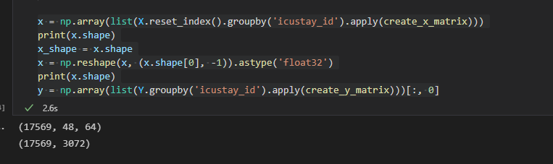
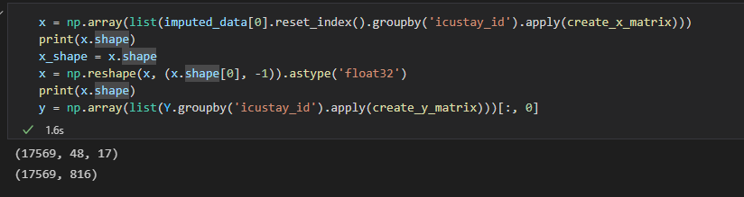
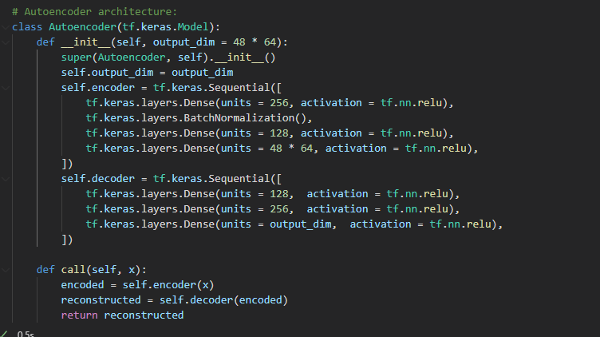
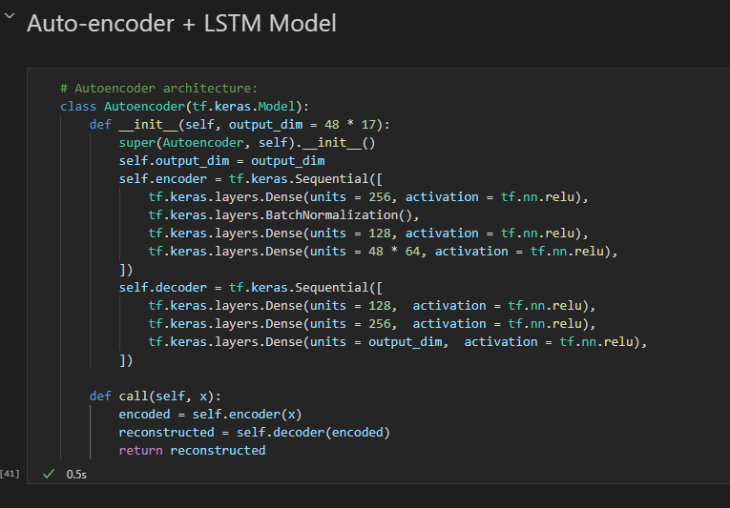
Original notebook
IMPUTED data

Slide 5
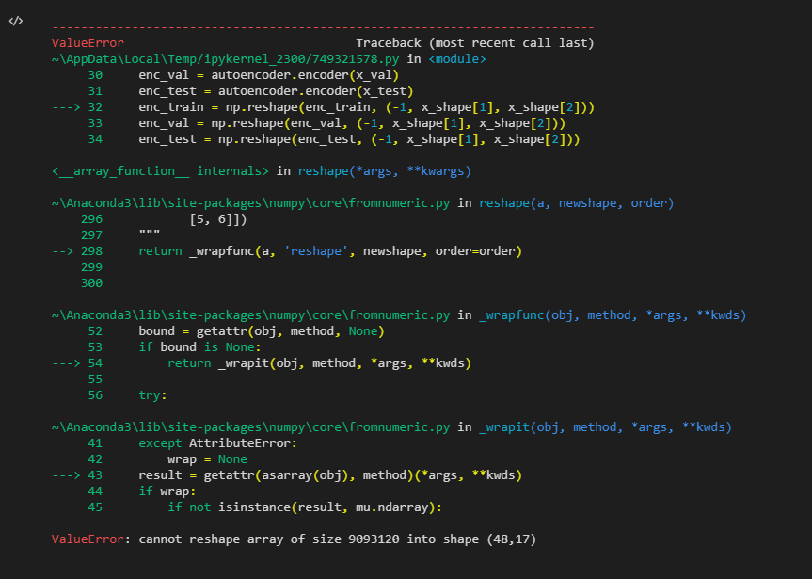
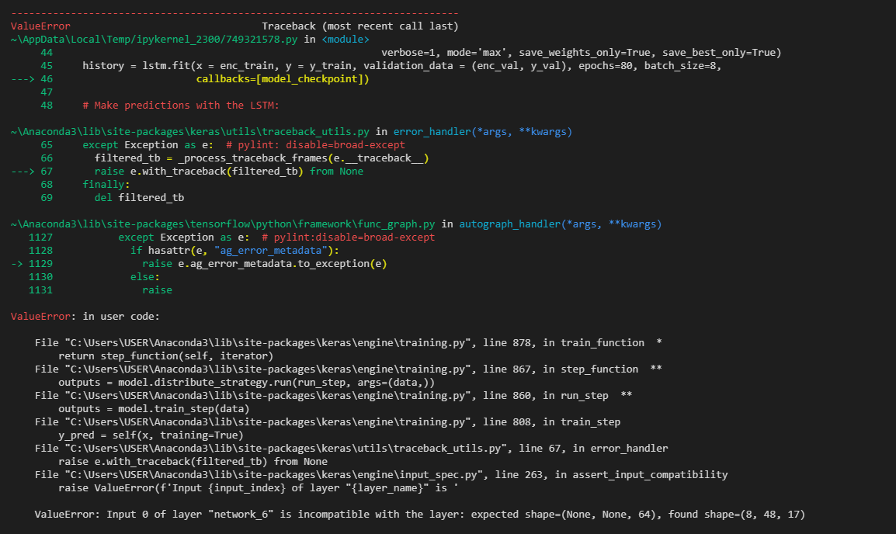
Deep learning classification
If I use the original architecture
If I change the output_dim

Slide 6
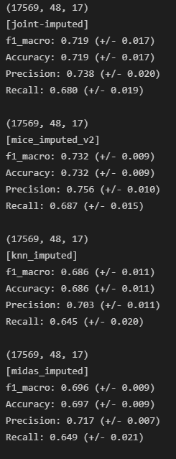
Performance after reshaping

Slide 7
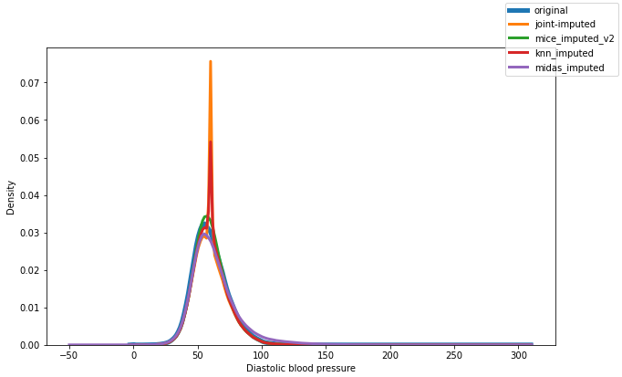
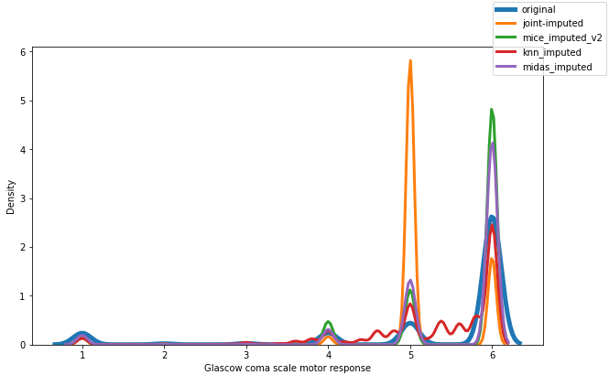
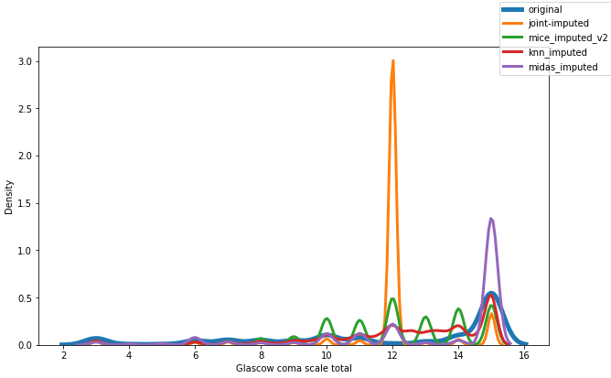
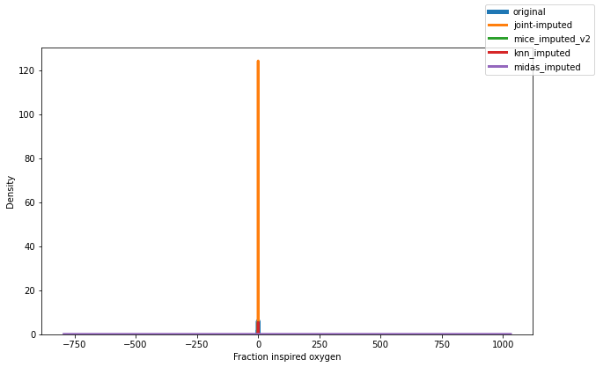
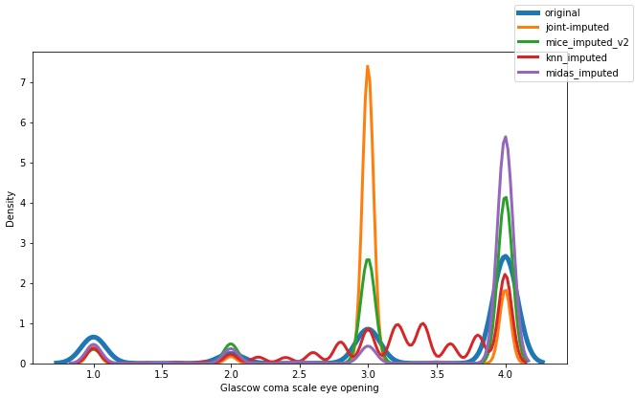
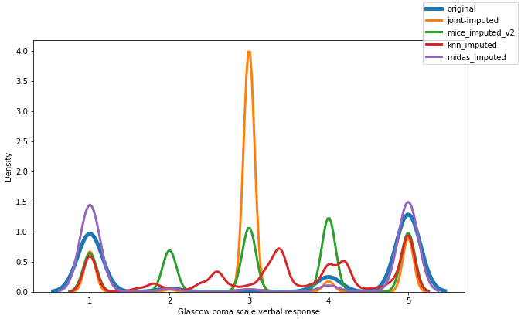
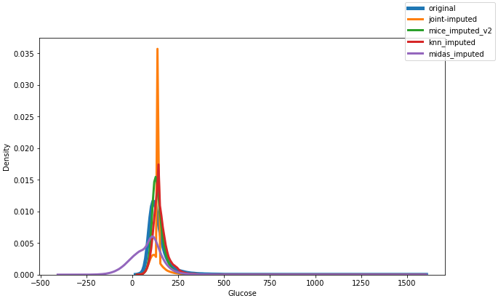
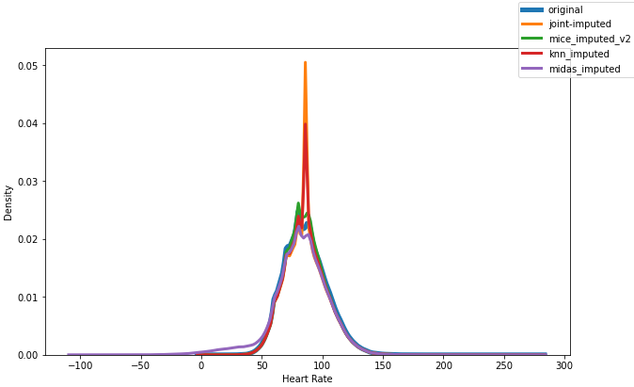
Distributions without removing outliers

Slide 8
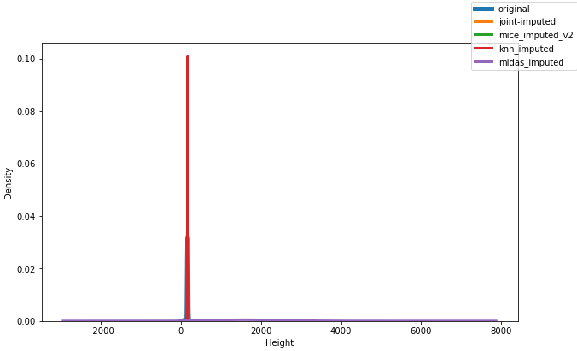
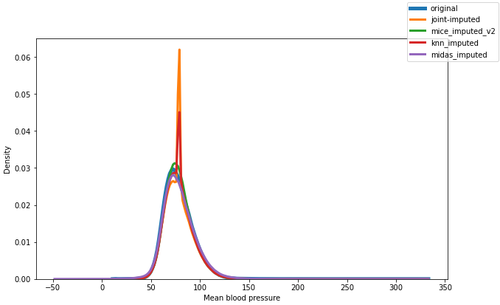
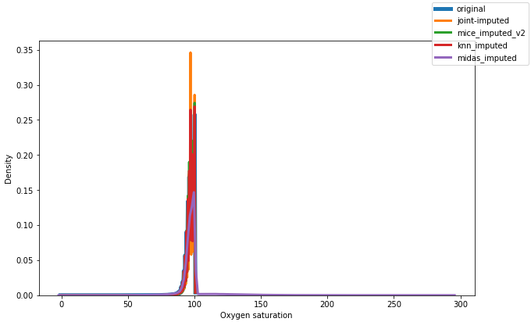
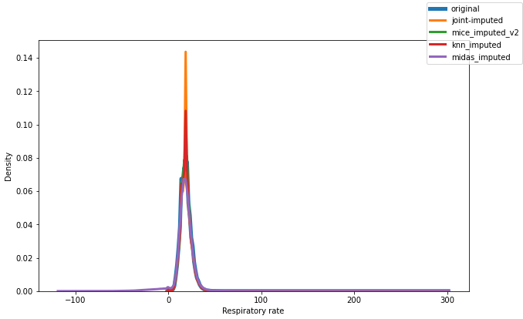
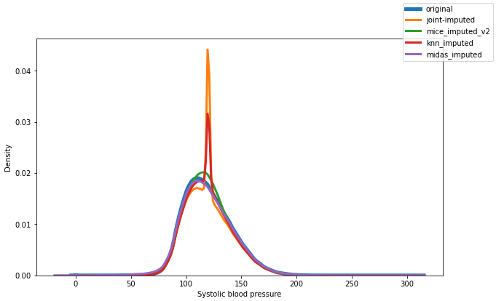
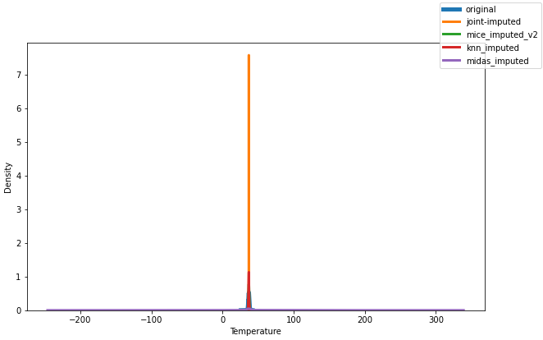
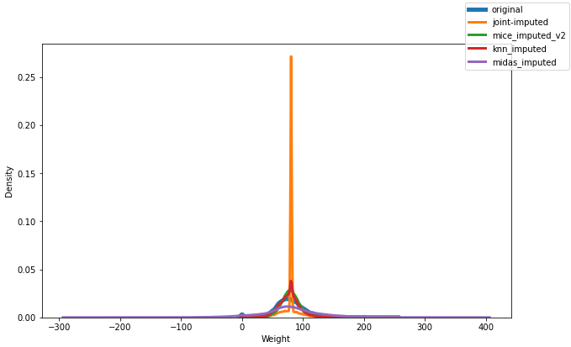
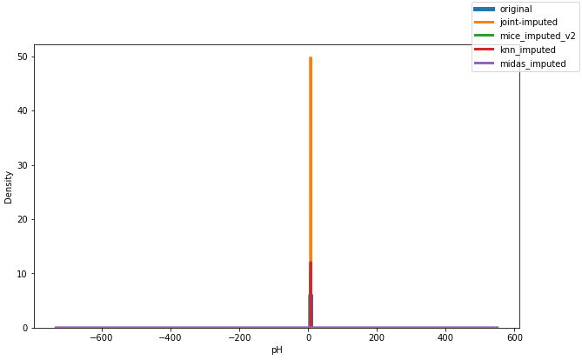

Slide 9
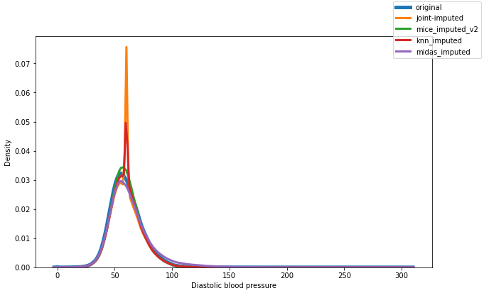
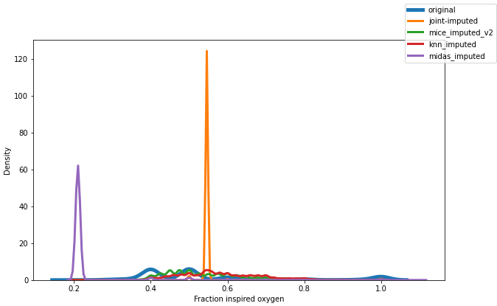
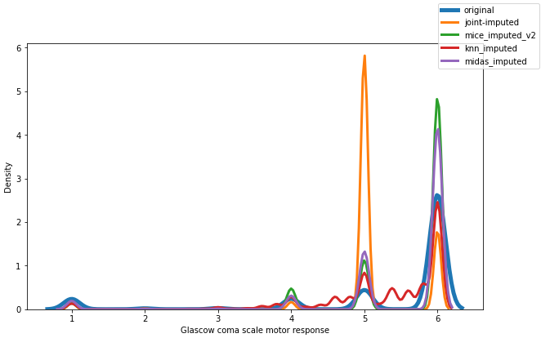
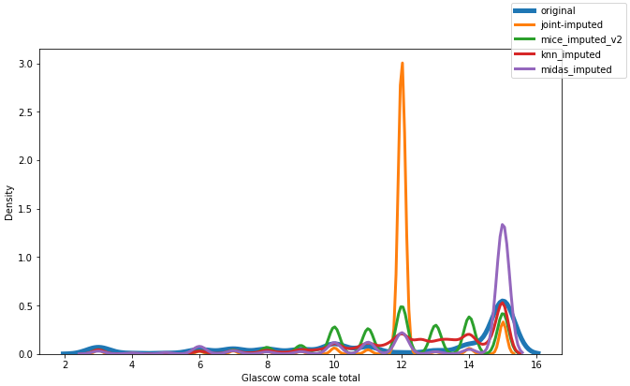
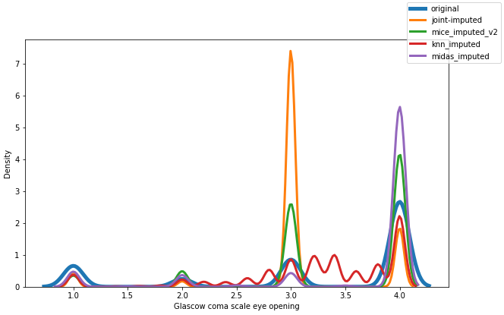

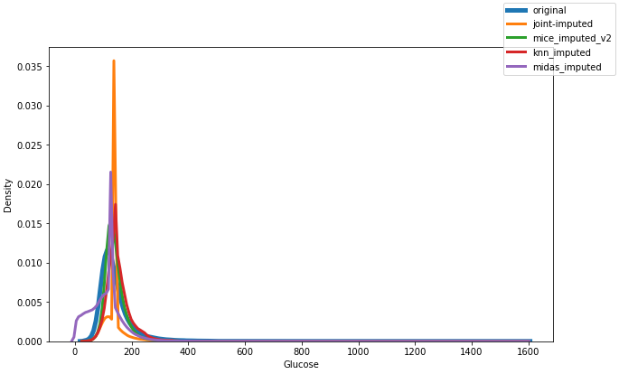
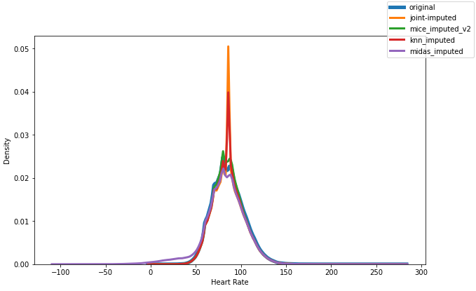
Distributions

Slide 10
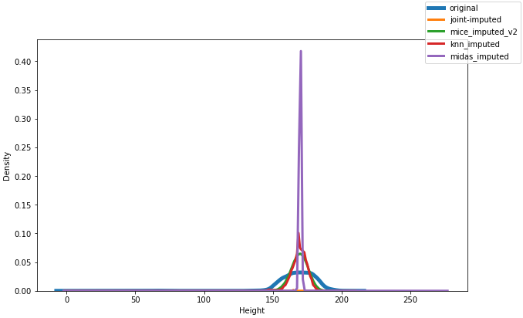
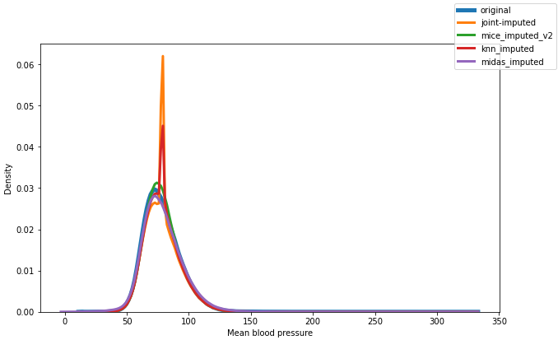
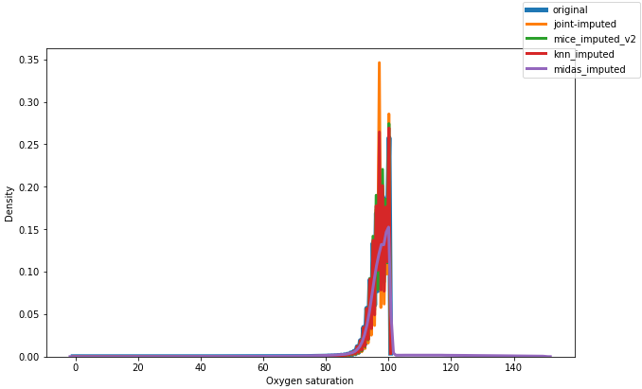
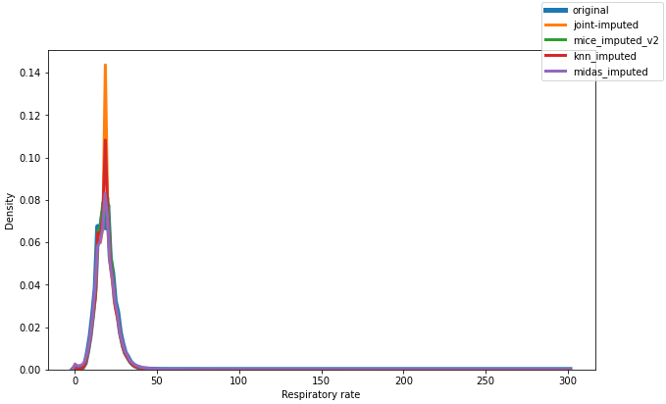
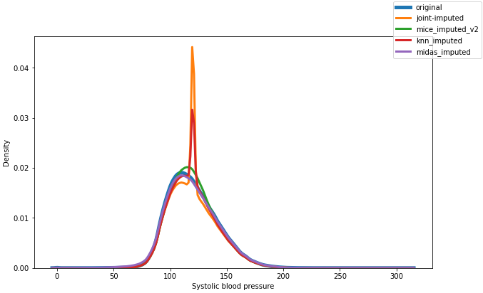
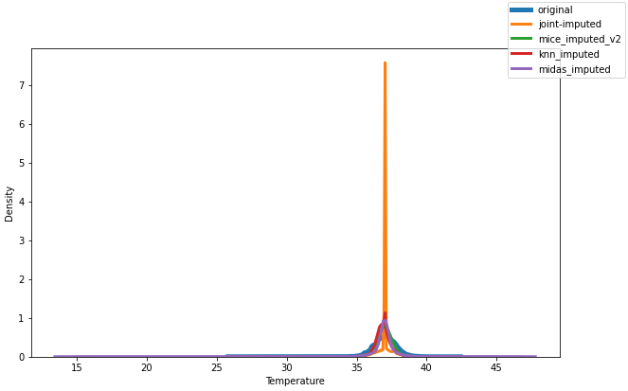
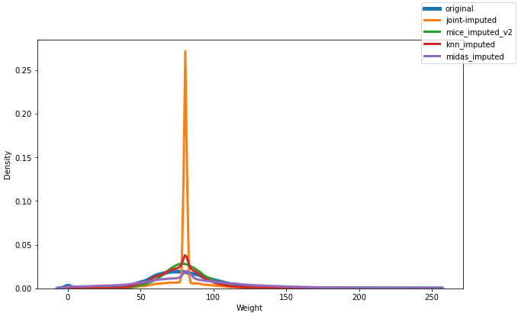
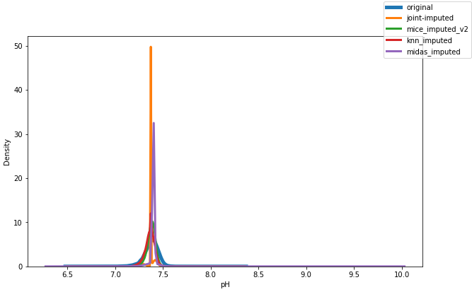

Slide 11
Switching focus
Is it possible to switch focus to creating an extraction pipeline
Show feature iimportance and select import features only
Using feature selection on different imputed data to find corelation

Slide 12
Feature importance

Slide 13
Plan for upcoming weeks
Jan 31- Feb 7: Create comparison metrics pipeline + Optimize models (make changes) + feature selection
Feb 7 – Feb 14: Look at extraction Pipeline + masked data prediction
Finish introduction and background
Feb 14 – Feb 21: Add imputation methods if all models are optimized + Deep learning classification
Finish Analysis/ requirements
Feb 21 – Feb 28: Design, Implementation
Feb 28 – Mar 7: Evaluation, Conclusion
Mar 7 - Mar 14: Complete First Draft 2 weeks before deadline

